Slide 1
Parental age & lifetime history of major depressive episode
Jennifer Dusendang

Slide 2
Overview
Research Question
Data
Variables
Models
Results
Implications

Slide 3
Research Question
Is there a relationship between maternal or paternal age and lifetime risk of Major Depressive Episode?

Slide 4
Data
National Comorbidity Survey Replication (NCS-R)
2001-2003

Slide 5
Variables
Predictors
Maternal Age
Paternal Age
Outcome
Lifetime History of Major Depressive Episode
Confounders
Participant’s age
Sex
Race / ethnicity
Parent education
Parent depression
Siblings

Slide 6
Logistic Regression Models
Model 1
A – Maternal age
B – Paternal age
Model 2
A – Maternal age + covariates
B – Paternal age + covariates
Model 3
Maternal age + paternal age + covariates
Alternative Models – U-shaped relationship

Slide 7
Results

Slide 8
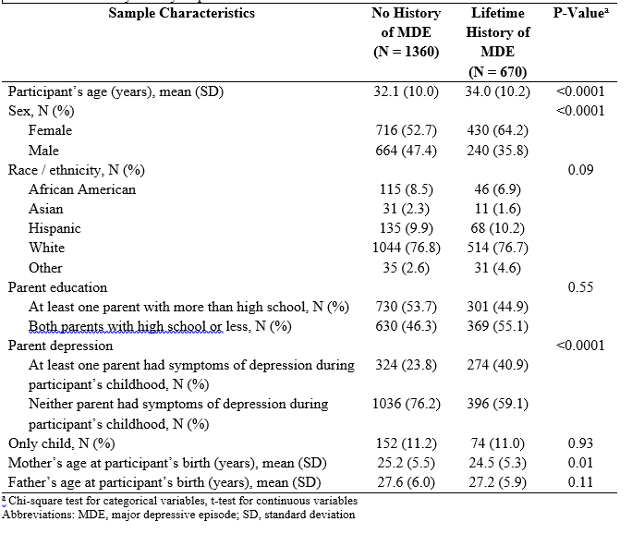
1/3 have lifetime history of Major Depressive Episode

Slide 9
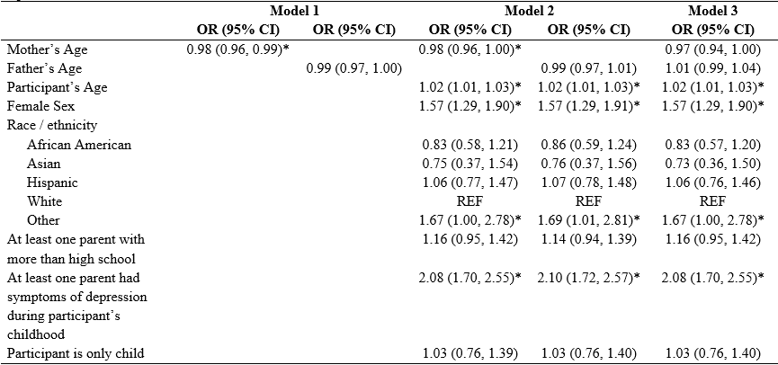

Slide 11
Implications
Potential for heightened risk of depression among those with younger mothers
These may also be families with lower resources
Making sure pediatricians can help young families access the resources they need for mental health services – both for parent and child

Slide 12
Questions?

